Slide 1
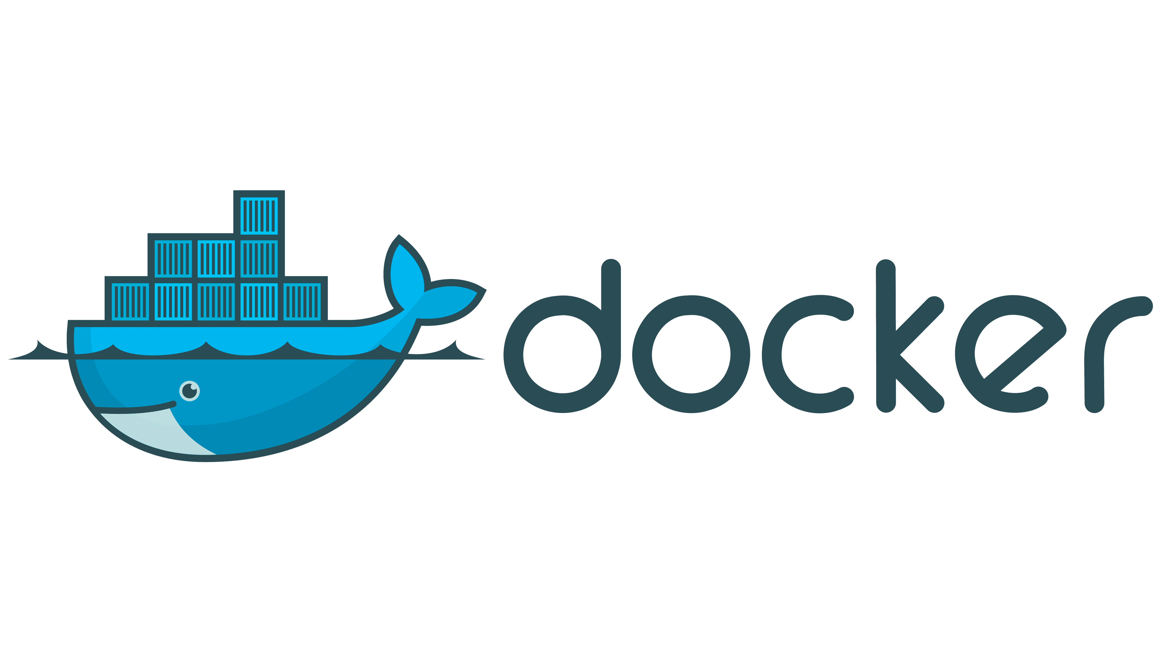
By – Dharmanshu
15 November 2024

Slide 2
What is Docker?
1. Docker is an open platform for developing, shipping, and running applications.
2. Docker enables you to separate your applications from your infrastructure so you can deliver software quickly.
3. It allows them to package applications and all their dependencies into a single, portable container. This container can run on any system, ensuring consistency across different environments.
4. Container is a lightweight, standalone, and executable unit that includes everything needed to run a piece of software: the code, runtime, libraries, and system tools. Docker allows developers to package applications with their dependencies into a single container that can run reliably across different computing environments.

Slide 3
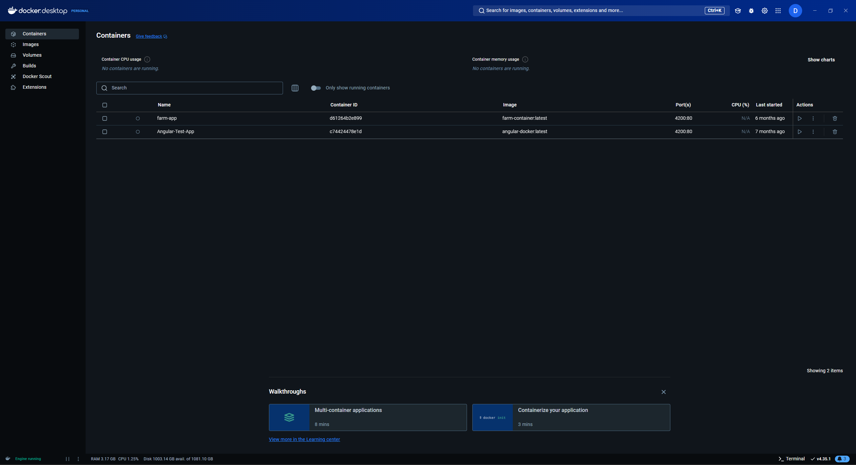
Key Components of Docker
1. Docker Engine: The core software that enables containerization. Ex. Docker Desktop.

Slide 4

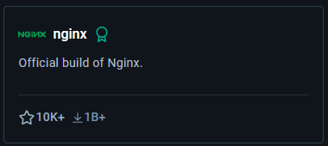
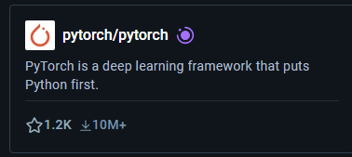
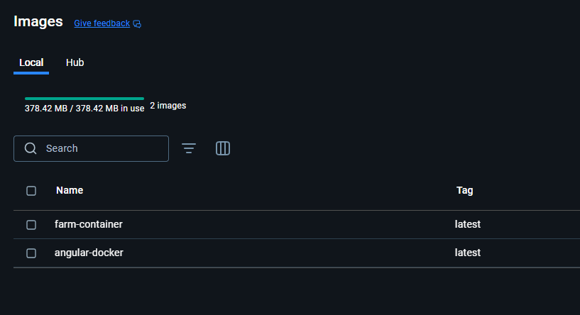
2. Images: Docker containers are created from Docker images. These images are blueprints that define the contents and configuration of the containers.
URL - Docker Hub Container Image Library | App Containerization

Slide 5
3. Dockerfile: Developers create Dockerfiles, which are scripts containing a series of instructions on how to build a Docker image. This might include instructions to install software, copy files, and set environment variables. A Dockerfile is a text-based document that's used to create a container image. It provides instructions to the image builder on the commands to run, files to copy, startup command, and more.
Some of the most common instructions in a Dockerfile include:
FROM <image> - this specifies the base image that the build will extend.
WORKDIR <path> - this instruction specifies the "working directory" or the path in the image where files will be copied and commands will be executed.
COPY <host-path> <image-path> - this instruction tells the builder to copy files from the host and put them into the container image.
RUN <command> - this instruction tells the builder to run the specified command.
ENV <name> <value> - this instruction sets an environment variable that a running container will use.
EXPOSE <port-number> - this instruction sets configuration on the image that indicates a port the image would like to expose.
USER <user-or-uid> - this instruction sets the default user for all subsequent instructions.
CMD ["<command>", "<arg1>"] - this instruction sets the default command a container using this image will run.
Dockerfile reference : Dockerfile reference | Docker Docs

Slide 6
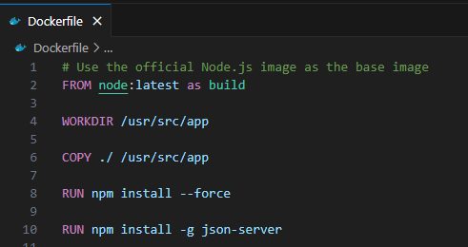

Slide 7
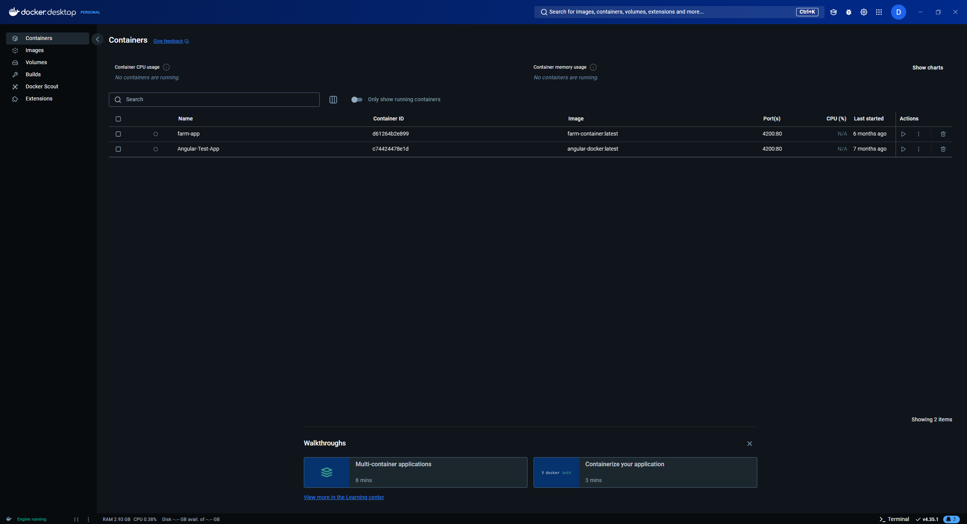
4. Containers: Runtime instances of images. These are isolated environments where applications run.

Slide 8
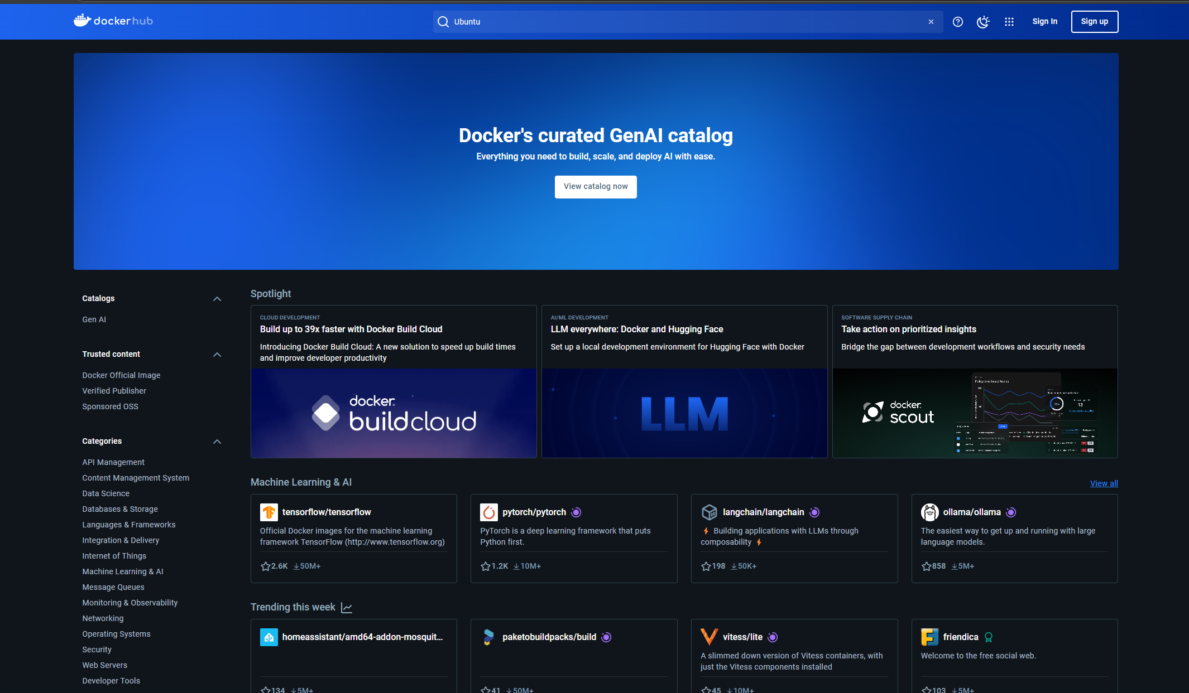
5. Registry/Hub: Docker Hub is a popular registry where developers can share and access Docker images. Think of it as a library where you can pull or push images. Docker Hub Container Image Library | App Containerization

Slide 9
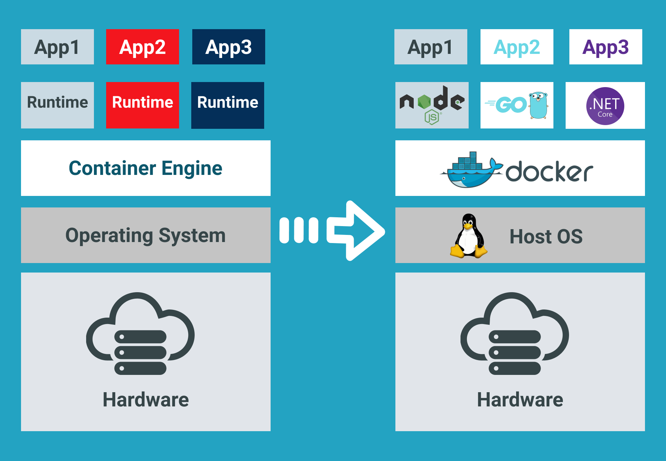

Slide 10
What are Containers?
A Docker container is a runtime instance of a Docker image—a snapshot of an application and its dependencies. Containers are similar to virtual machines (VMs) but are more lightweight because they share the operating system (OS) kernel with the host, making them faster to create, run, and scale.
Container images become containers at runtime and in the case of Docker containers – images become containers when they run on Docker Engine. Available for both Linux and Windows-based applications, containerized software will always run the same, regardless of the infrastructure. Containers isolate software from its environment and ensure that it works uniformly despite differences for instance between development and staging.

Slide 11
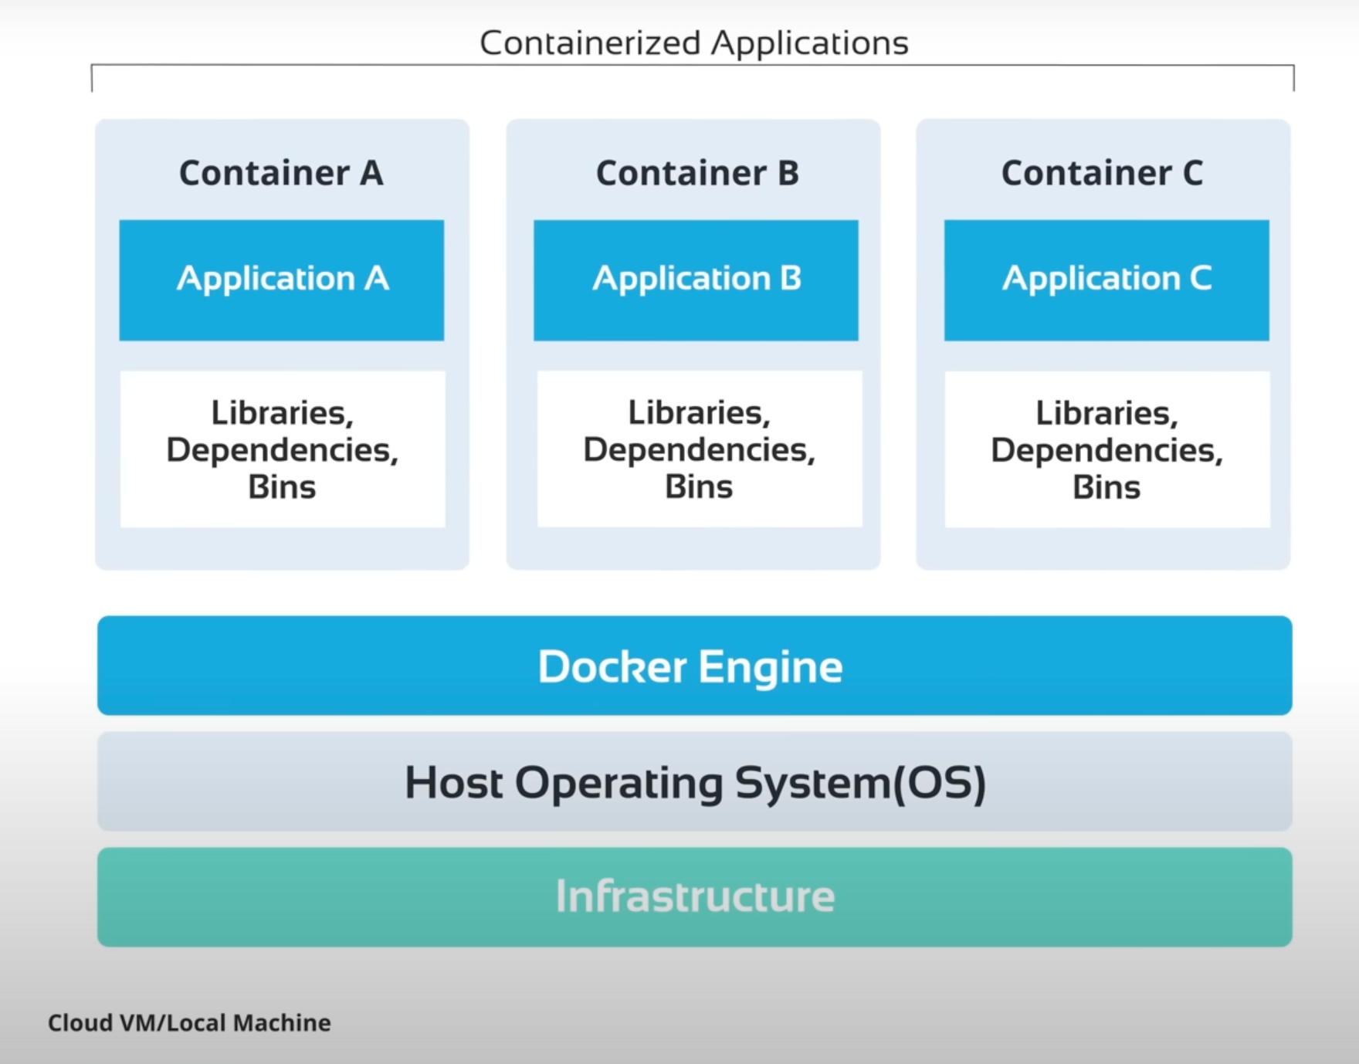

Slide 12
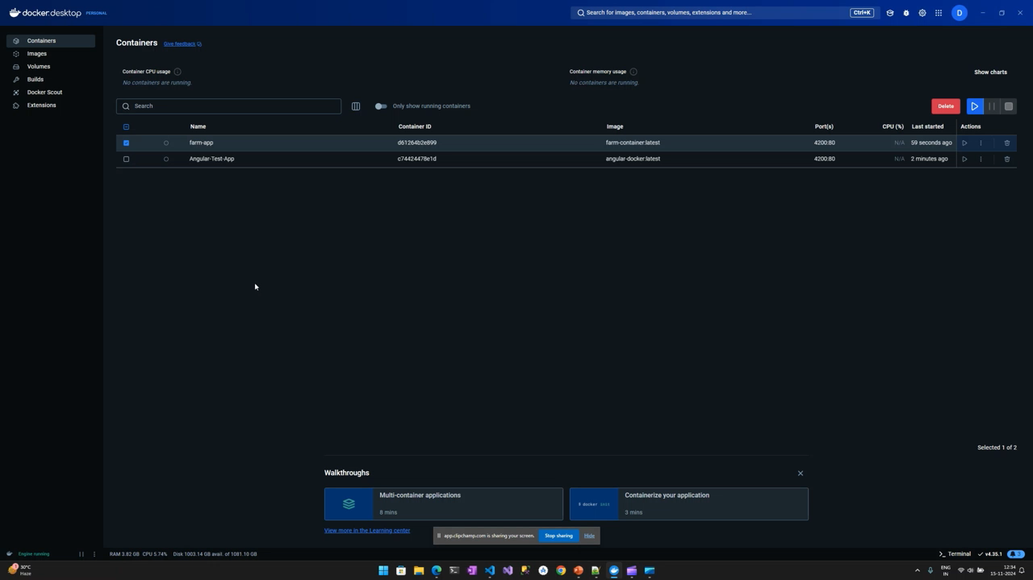

Slide 13
.NET and Docker
1. .NET Images
A) microsoft/dotnet - Docker Image | Docker Hub
B) Microsoft Artifact Registry
C) .NET Chiseled Containers : .NET chiseled Ubuntu container images are now GA and can be used in production, for .NET 6, 7, and 8. These images are ~100 MB smaller than the regular Ubuntu images.

Slide 14
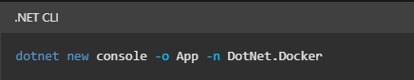
1. Building container .NET App
dotnet-docker/samples/README.md at main · dotnet/dotnet-docker
dotnet-docker/samples/releasesapi/README.md at main · dotnet/dotnet-docker
Example - Containerize an app with Docker tutorial - .NET | Microsoft Learn
1.1 Create .NET app
1. dotnet new console -o App -n DotNet.Docker

Slide 15
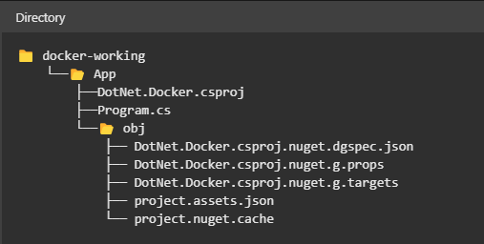
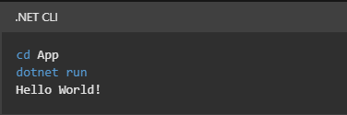
1. Your folder tree looks similar to the following directory structure:
2. Now, you change directories and navigate into the App folder from your terminal session. Use the dotnet run command to start the app. The application runs, and prints Hello World! below the command:

Slide 16
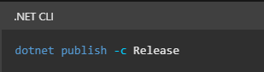
1.2 Publish .NET app
> dotnet publish -c Release
The path to the publish folder from the working folder should be
.\App\bin\Release\net8.0\publish\

Slide 17
2. Create the Dockerfile & Image
1. Create a file named Dockerfile in the directory containing the .csproj and open it in a text editor
FROM mcr.microsoft.com/dotnet/runtime:8.0 AS build-env
WORKDIR /App
# Copy everything
COPY . ./
# Restore as distinct layers
RUN dotnet restore
# Build and publish a release
RUN dotnet publish -c Release -o out
# Build runtime image
FROM mcr.microsoft.com/dotnet/aspnet:8.0@sha256:6c4df091e4e531bb93bdbfe7e7f0998e7ced344f54426b7e874116a3dc3233ff
WORKDIR /App
COPY --from=build-env /App/out .
ENTRYPOINT ["dotnet", "DotNet.Docker.dll"]

Slide 18
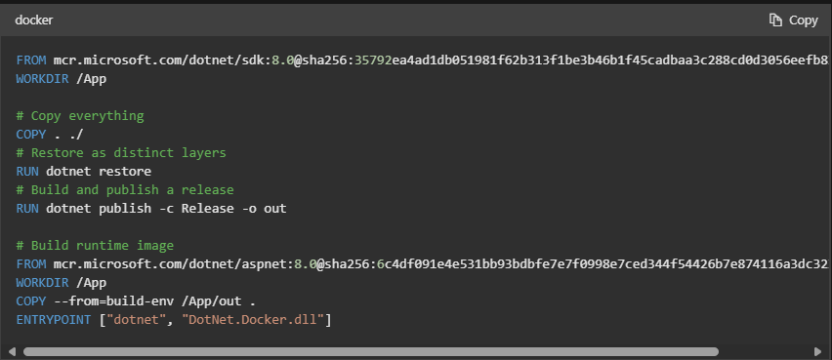

Slide 19
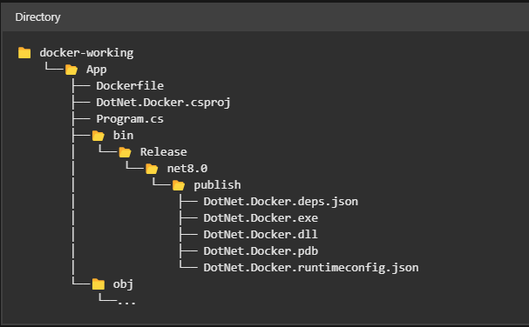
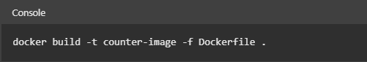
2. The directory structure of the working folder should look like the following.
3. To build the container, from your terminal, run the following command:
> docker build -t counter-image -f Dockerfile .
OR
> docker build --pull --rm -f "Dockerfile" -t test-app:latest ".“

Slide 20
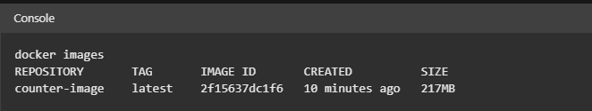
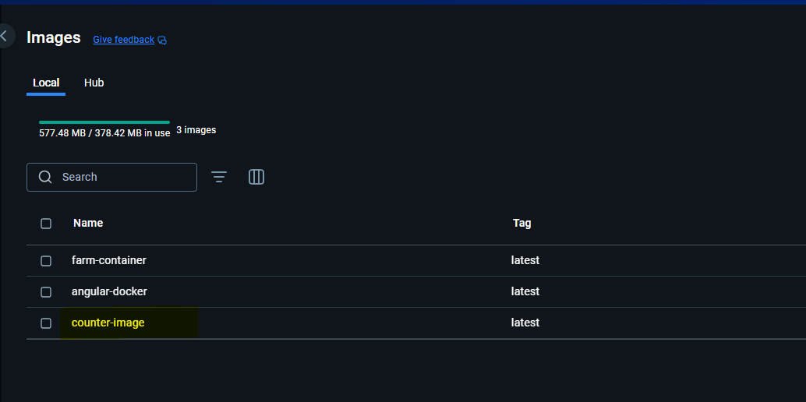
3. This command builds the image and creates a local repository named counter-image that points to that image.

Slide 21
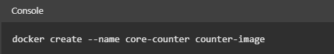
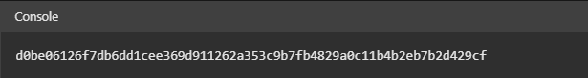
3. Create a container
1. Now that you have an image that contains your app, you can create a container
> docker create --name core-counter counter-image
2. This docker create command creates a container based on the counter-image image. The output of that command shows you the CONTAINER ID (yours will be different) of the created container:

Slide 22
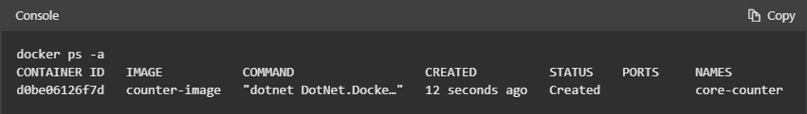
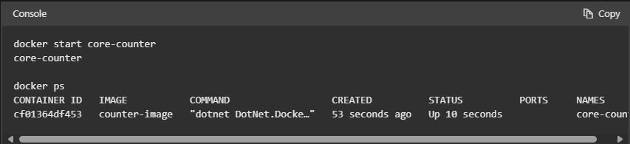
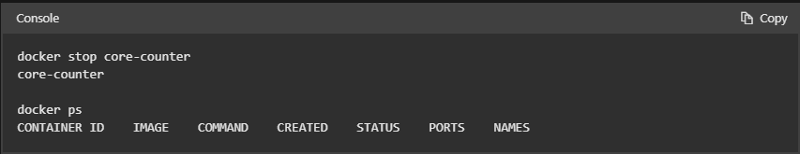
3. To see a list of all containers, use the docker ps -a command:
The container was created with a specific name core-counter
4. uses the docker start command to start the container, and then uses the docker ps command to only show containers that are running:

Slide 23
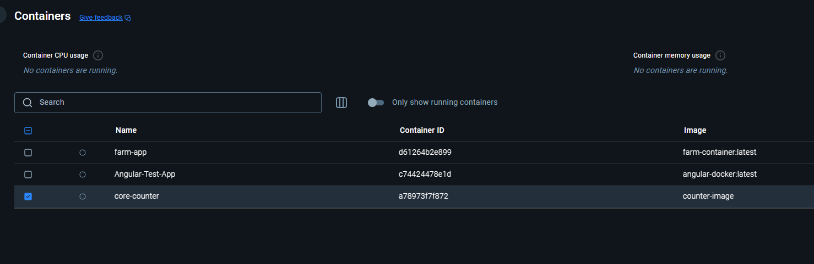

Slide 24
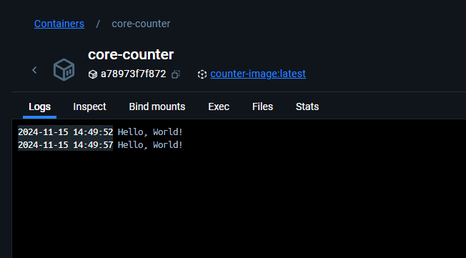
Output
dotnet/dotnet-docker: Docker images for .NET and the .NET Tools.

